Slide 1
Synchronization: Semaphores and Monitors
Manish Shrivastava

Slide 2
Dining-Philosophers Problem
Five philosophers spend their lives thinking and eating.
They share a common circular table surrounded by five chairs.
Five single chopsticks are available.
Whenever a philosopher wants to eat, he tries to pick up two chopsticks that are closest to him/her.
A philosopher can not pick the chopstick in the hand of neighbor.
After finishing, the philosopher puts back the chopsticks and starts thinking.
It is simple representation of the need to allocate several resources among several processes in a deadlock and starvation free manner.

Slide 3
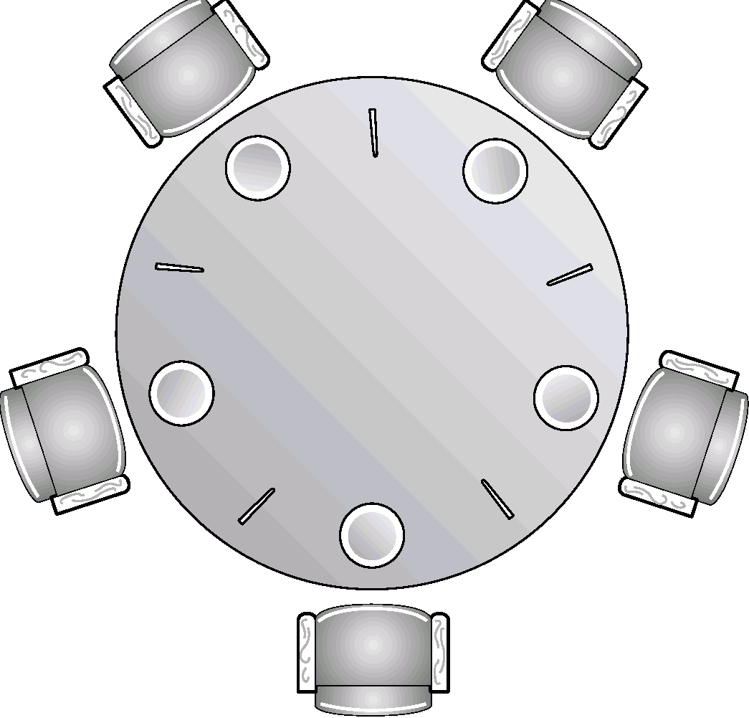
Dining-Philosophers Problem

Slide 4
Dining-Philosophers Problem
Shared data
semaphore chopstick[5];
Initially all values are 1
Philosopher i:
do {
wait(chopstick[i])
wait(chopstick[(i+1) % 5])
…
eat
…
signal(chopstick[i]);
signal(chopstick[(i+1) % 5]);
…
think
…
} while (1);
The solution creates a deadlock

Slide 5
Implementation of Semaphores
wait and signal operations are atomic.
Good Solution: implement through hardware or firmware.
Other solutions
Ensure that only one process manipulates “wait” and “signal” operations.
One can use Dekker’s algorithm or Peterson’s algorithm
Substantial processing overhead
Use one of the hardware supported schemes
Test and set
disabling interrupts (single processor)
The wait and signal code is very short the amount of busy waiting involved is short.

Slide 6
Two possible implementations of Semaphores
Wait(s) { while(!testset(s.flag)) /* do nothing */ s.count--; if (s.count <0) { place this process in s.queue; block this process (set s.flag to 0) } else s.flag=0; } | Wait(s) { Inhibit interrupts s.count--; if (s.count <0) { place this process in s.queue; block this process allow interrupts } else allow interrupts; }
Signal(s) { while(!testset(s.flag)) /* do nothing */ s.count++; if (s.count <= 0) { remove a process P from s.queue; Place a process P in the ready list } s.flag=0; } | Signal(s) { Inhibit interrupts; s.count++; if (s.count <= 0) { remove a process P from s.queue; Place a process P in the ready list } allow interrupts; }

Slide 7
Problem with semaphores
Incorrect use may result in timing errors
These errors are difficult to detect as these occur if only particular sequence occurs.
Missing or reverse order.
It is difficult to produce correct program using semaphores.
The wait and signal operations are scattered throughout the program and it is difficult to see overall effect of these operations on the semaphores.

Slide 8
Problem with semaphores (cont.)
Problems
Suppose a process interchanges the order in which wait and signal operations on the semaphore are executed
signal (mutex)
CS
wait (mutex)
Several processes may be executing in their CS simultaneously.
Suppose that a process replaces signal(mutex) with wait(mutex)
signal (mutex) wait(mutex)
CS CS
signal (mutex) wait(mutex)
Deadlock will occur.
Suppose a process omits wait(mutex) or signal(mutex) or both.
ME is violated or deadlock occurs.
A critical region and monitor concept is introduced to address this problem

Slide 9
High level synchronization constructs
To deal with the type of errors caused by semaphores, high-level constructs have been introduced.
Critical region
Monitor
Assumption
Process contains some local data
Local data can be accessed by only the sequential program that is encapsulated within the same process.
Process can not access the local data of another process.

Slide 10
Monitors
It is an high level synchronization construct.
A monitor is a software module consisting of one or more procedures, an initialization sequence and local data.
Main characteristics
The local data variables are accessible only by the monitor’s procedures and not by any external procedure.
A process enters monitor by entering one of its procedures.
Only one process may be executing (active) in the monitor at any time; any other process that has invoked the monitor is suspended while waiting for the monitor to become available.
1&2 → object oriented characteristics.
By enforcing one procedure at a time, the monitor enforces ME facility.

Slide 11
Monitors
High-level synchronization construct that allows the safe sharing of an abstract data type among concurrent processes.
A shared data resource can be protected by placing in the monitor.
monitor monitor-name
{
shared variable declarations
procedure body P1 (…) {
. . .
}
procedure body P2 (…) {
. . .
}
procedure body Pn (…) {
. . .
}
{
initialization code
}
}

Slide 12
Monitors
To allow a process to wait within the monitor, a condition variable must be declared, as
condition x, y;
Condition variable can only be used with the operations wait and signal.
The operation
x.wait(); means that the process invoking this operation is suspended until another process invokes
x.signal();
The x.signal operation resumes exactly one suspended process. If no process is suspended, then the signal operation has no effect.

Slide 13
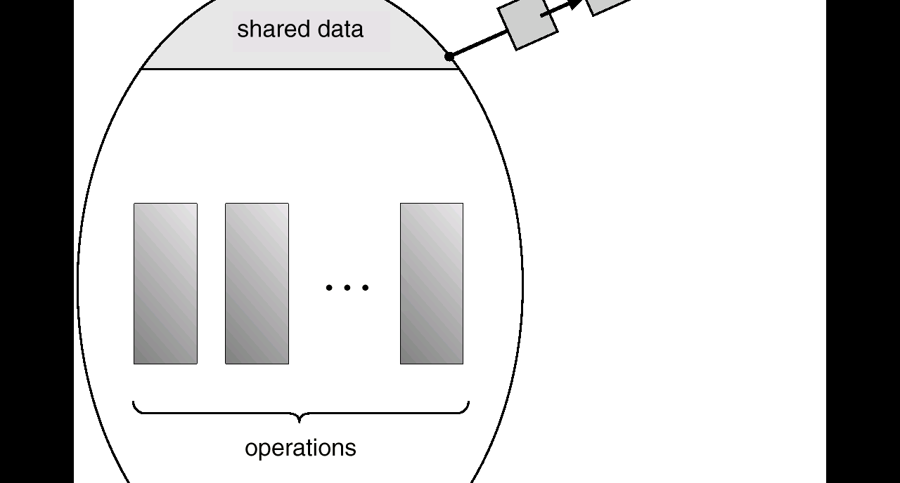
Schematic View of a Monitor

Slide 14
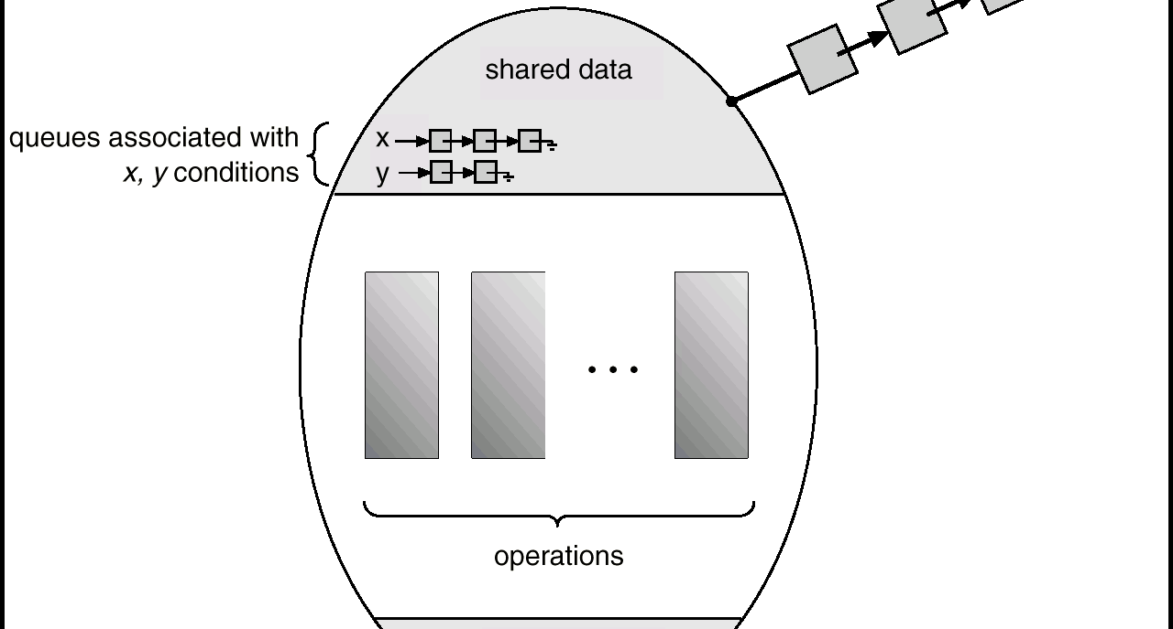
Monitor With Condition Variables

Slide 15
Monitors
In case of monitors, the monitor construct itself provides ME, but synchronization is provided by the programmer.
In case of semaphore, both ME and synchronization are provided by the programmer.
Also , in case of monitors also, it is possible to make mistakes in the synchronization of monitors.
For example if signal function is omitted, the processes entering corresponding queue are permanently hung up.
However, since all synchronization functions are confined to monitor, it is easier to verify the synchronization and detect bugs.
Once a monitor is correctly programmed, access to the protected resource is correct from all processes.
With semaphores, resources access is correct only if all of the processes that access the resource are programmed correctly.

Slide 16
Dining Philosophers Example Deadlock free solution
A philosopher is allowed to pick up his chopsticks only if both of them were available.
We introduce three states:
Enum {thinking, hungry, eating} state[5]
Philosopher i can set the variable state[i]=eating only if her two neighbors are not eating: (state[(i+4)%5]!=eating) and (state(i+1)%5)!=eating)
We also declare condition self[5];
Philosopher i can delay himself when he is hungry, but unable to obtain the chopsticks he needs.

Slide 17
Dining Philosophers Example Deadlock free solution
monitor dp
{
enum {thinking, hungry, eating} state[5];
condition self[5];
void pickup(int i) // following slides
void putdown(int i) // following slides
void test(int i) // following slides
void init() {
for (int i = 0; i < 5; i++)
state[i] = thinking;
}
}

Slide 18
Dining Philosophers
void pickup(int i) {
state[i] = hungry;
test[i]; // if left and right of i are not eating, then eat.
if (state[i] != eating)
self[i].wait();
}
void putdown(int i) {
state[i] = thinking;
// test left and right neighbors
test((i+4) % 5);
test((i+1) % 5);
}

Slide 19
Dining Philosophers
void test(int i) {
if ( (state[(I + 4) % 5] != eating) &&
(state[i] == hungry) &&
(state[(i + 1) % 5] != eating)) {
state[i] = eating;
self[i].signal();
}
}

Slide 20
Dining Philosophers
dp.pickup(i);
….
eat
….
dp.putdown(i);
It is easy to show that no two neighbors are eating simultaneously and no deadlocks will occur.
However, it is possible for a philosopher to starve to death.

Slide 21
Monitor Implementation Using Semaphores
Variables
semaphore mutex; // (initially = 1)
semaphore next; // (initially = 0)
int next-count = 0; // number of processes suspended on next.
Each external procedure F will be replaced by
wait(mutex);
…
body of F;
…
if (next-count > 0)
signal(next)
else
signal(mutex);
Mutual exclusion within a monitor is ensured.

Slide 22
Monitor Implementation
For each condition variable x, we have:
semaphore x-sem; // (initially = 0)
int x-count = 0;
The operation x.wait can be implemented as:
x-count++;
if (next-count > 0)
signal(next);
else
signal(mutex);
wait(x-sem);
x-count--;

Slide 23
Monitor Implementation
The operation x.signal can be implemented as:
if (x-count > 0) {
next-count++;
signal(x-sem);
wait(next);
next-count--;
}

Slide 24
Monitor Implementation
Conditional-wait construct: x.wait(c);
c – integer expression evaluated when the wait operation is executed.
value of c (a priority number) stored with the name of the process that is suspended.
when x.signal is executed, process with smallest associated priority number is resumed next.
Check two conditions to establish correctness of system:
User processes must always make their calls on the monitor in a correct sequence.
Must ensure that an uncooperative process does not ignore the mutual-exclusion gateway provided by the monitor, and try to access the shared resource directly, without using the access protocols.

